Slide 1

Weather Application
https://github.com/sashacozub/weather_application

Slide 2

Purpose of the application
The Weather Application is designed in a clean and simple manner, providing users with timely and accurate weather information based on either their current location or any other desired location of their choice. Additionally, users can select their preferred units of measurement.
The web application offers only the essential weather data, enabling users to make quick and informed decisions about their activities. Its responsive design ensures compatibility with all types of screen sizes, making it easily accessible anytime and on any device.

Slide 3
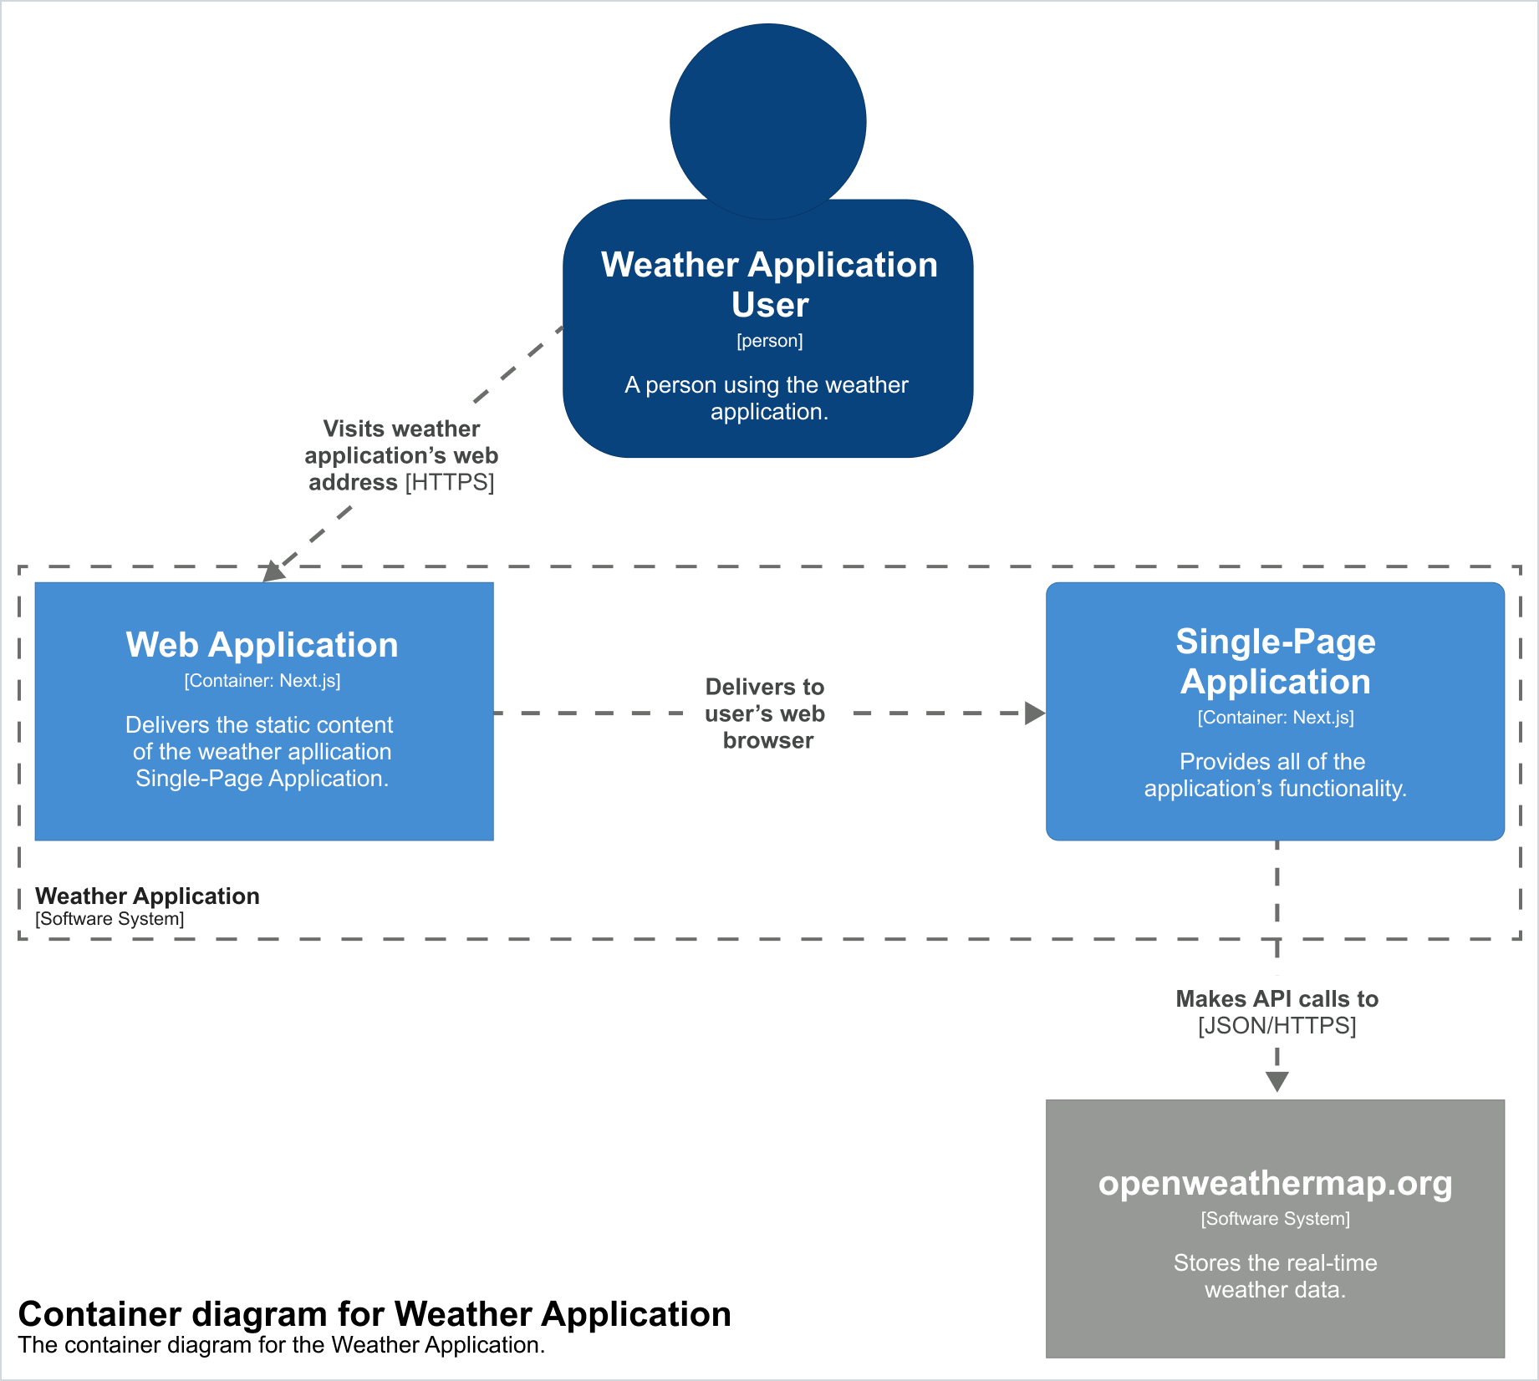
Architecture diagram of the Weather Application

Slide 4

Technology Choices
Next.js – full stack React framework.
TailwindCSS – A utility-fist CSS framework.
Axios – a promise-based HTTP Client for Node.js and browser.
TanStack Query - asynchronous state management.
Openweathermap.com – API for fetching weather data.

Slide 5
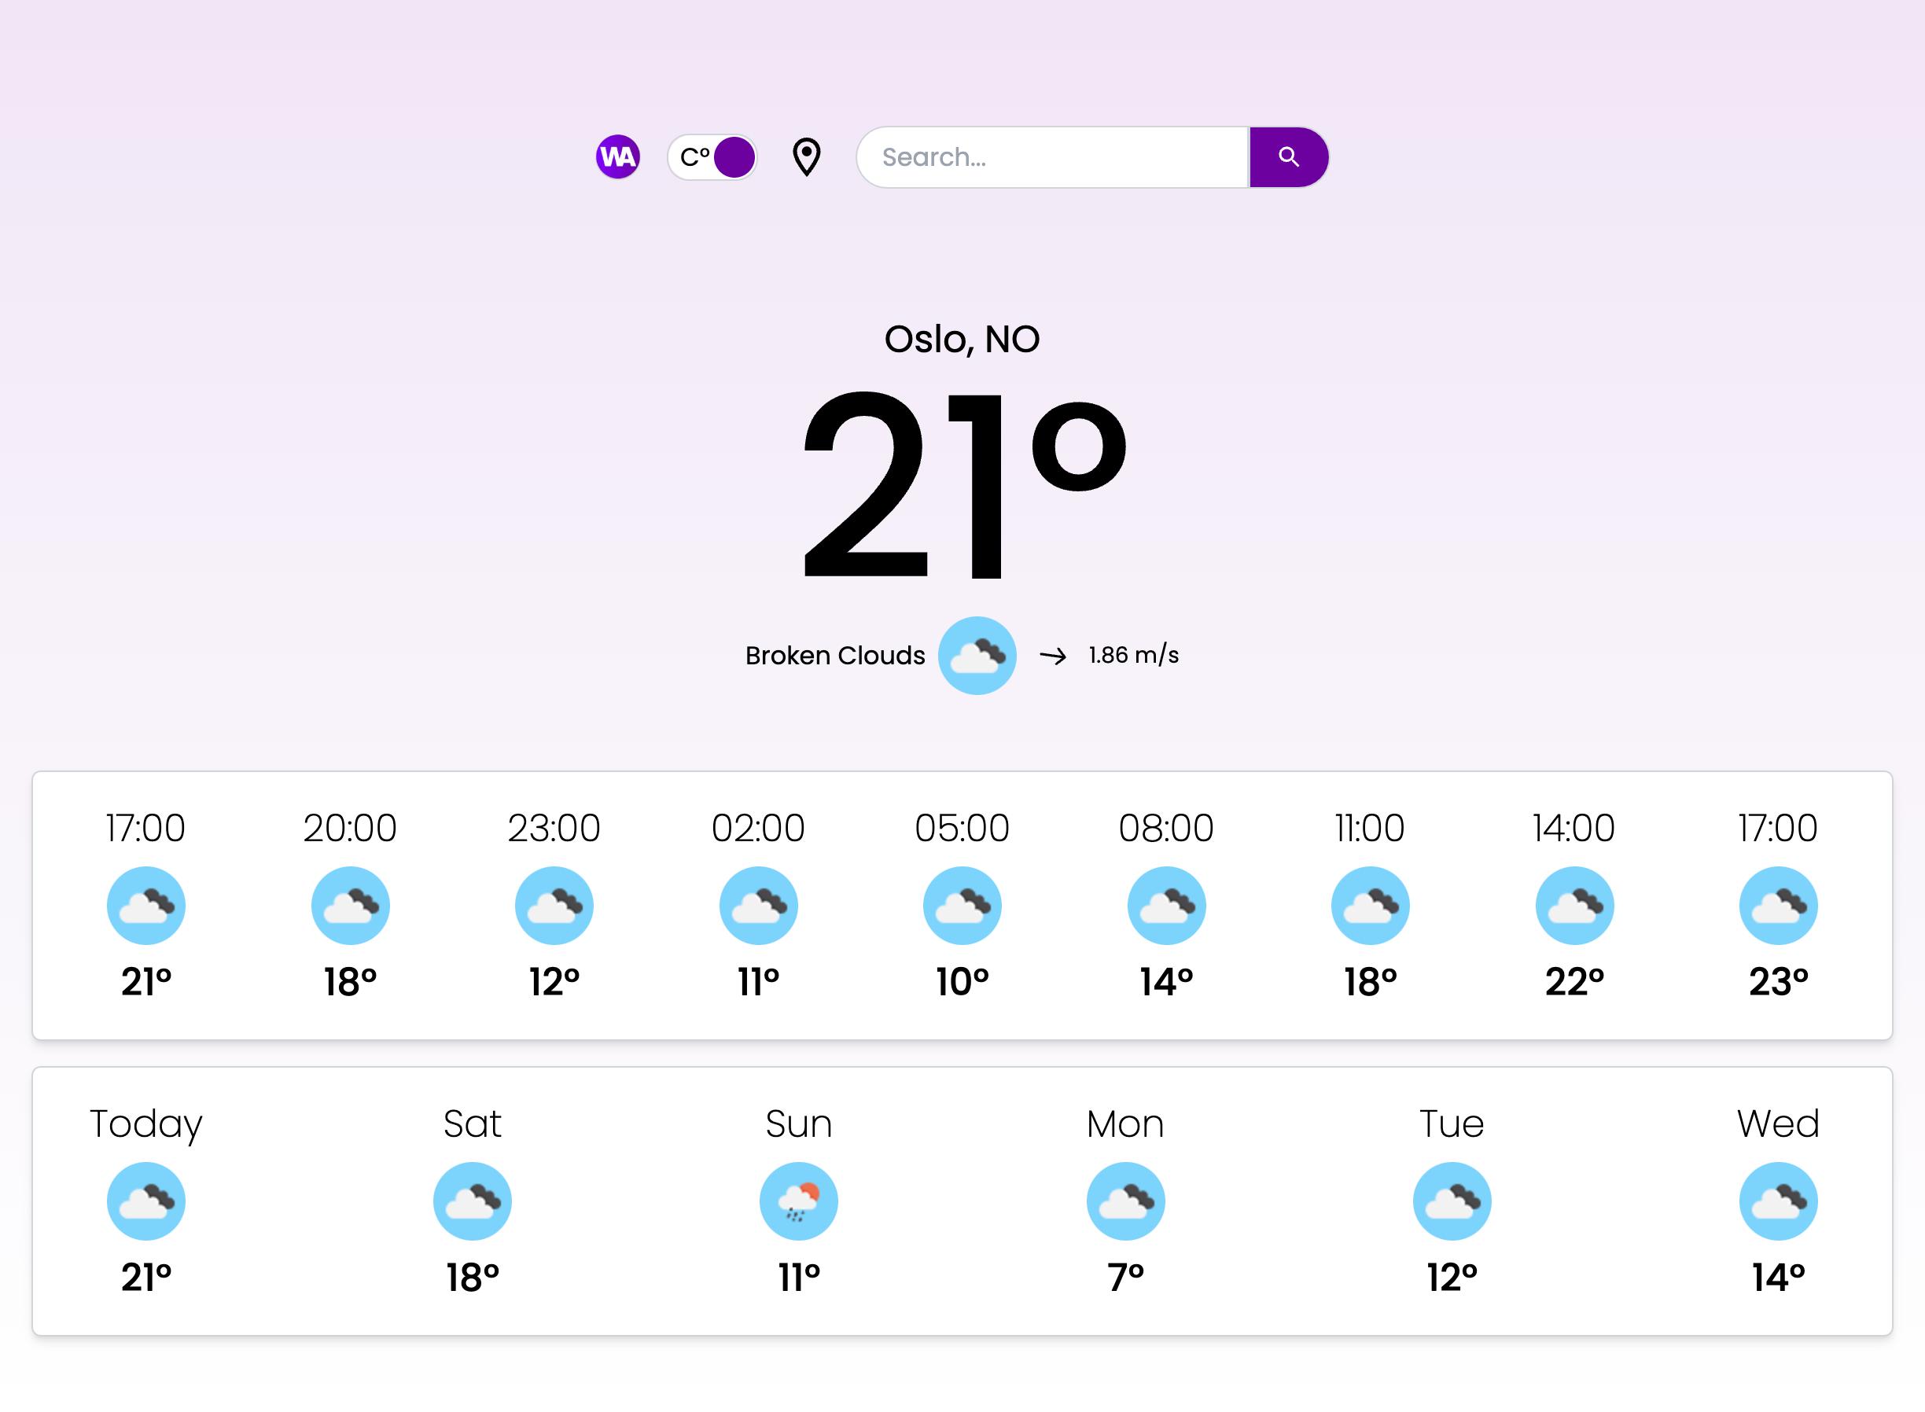
Screenshots
The following screenshot is Weather Application as seen on desktop computers.

Slide 6
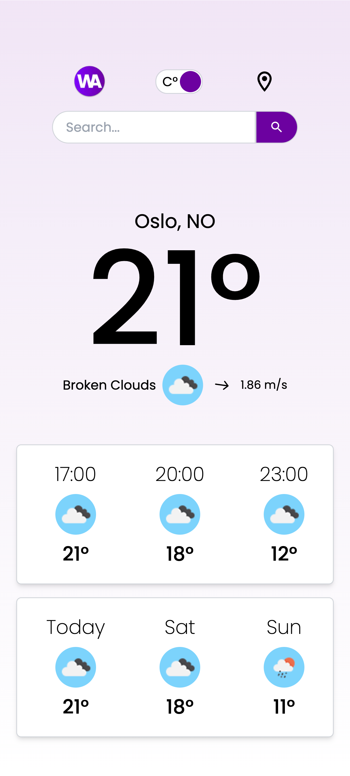
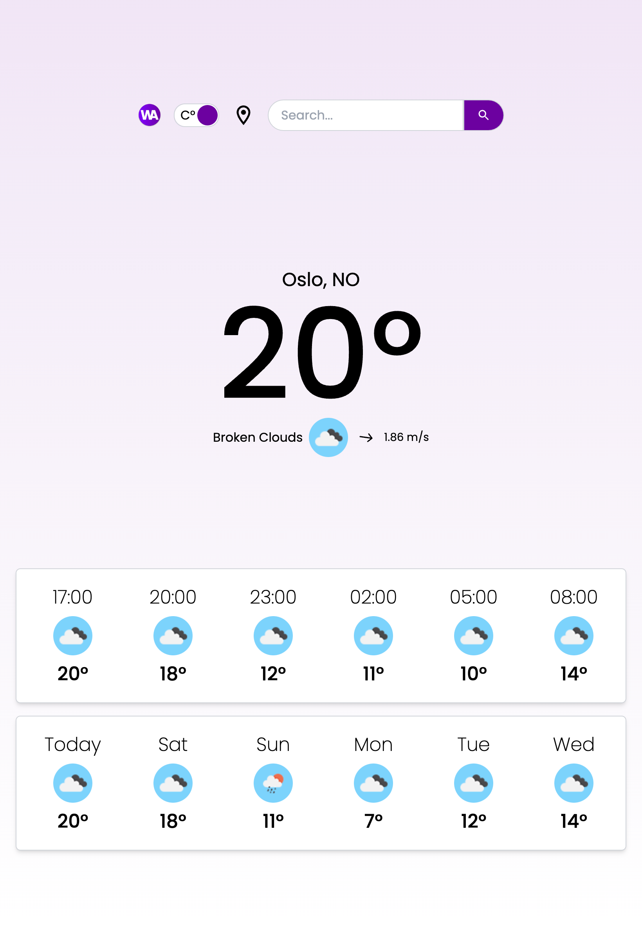
Screenshots
The following screenshots is Weather Application as seen on mobile devices and tablets.

Slide 7
Test Data & Test Cases
There is minimal number of elements that the user is interacting with. The following are the test cases and test data of the Weather Application.
Home Page Navigation: Click on Weather Application (WA) Logo → Reload the page.
Temperature Format Switch Button: Click the temperature switch button → Toggle between Celsius and Fahrenheit.
Current User Location Button: Click the current location button → Fetch and display weather for the user’s current geolocation.
Search Bar (Enter Key): Type a location name and press Enter → Fetch and display weather for the entered location.
Search Bar (Search Button): Type a location name and click the search button → Fetch and display weather for the entered location.
Test Data – Valid Location: Type "London" and press Enter or click search → Fetch and display weather for London.
Test Data – Invalid Location: Type "Londonn" or ”asdfgh" and press Enter or click search → Show "Location not found" notification for 3 seconds.

Slide 8
Changes from Conception Phase
The initial idea during the Conception phase was to fetch data for at least 7 days, but due to the limitations of the API used in the application, it is only possible to fetch weather data for maximum number of 5 days.

Slide 9

Installation and Running of the app
To run the Weather Application locally following steps must be taken:
1. Clone the repository: git clone https://github.com/your-username/your-project.git
https://github.com/sashacozub/weather_application
2. Navigate to project directory: cd your-project
3. Install dependencies: npm install / yarn install
4. Inside “.env.local”, located in root directory, instead of YOUR_API_KEY insert 9a5fd0cba154cf67a2e72ae790849b96
5. In order to build the optimized production bundle and start a production server to serve the application, use the following commands: npm run build
And then: npm start
6. Open http://localhost:3000, or the one that was started by your IDE

Slide 10
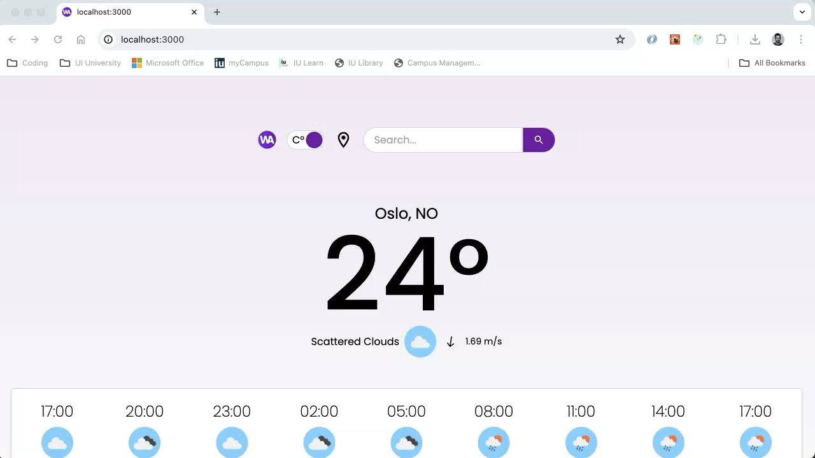
Screencast

